Slide 1
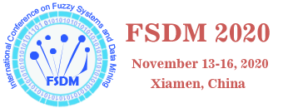
Drilling Time Series Analysis with Deep Kalman Filter
Yingwei Yu
Artificial Intelligence Engineer, Schlumberger
Katy, TX, USA
yingweiy@gmail.com

Slide 2
Outline
Introduction to Kalman Filter and Well Construction System
Method
Applications
Data generation
Regression
Classification
Unsupervised learning

Slide 3
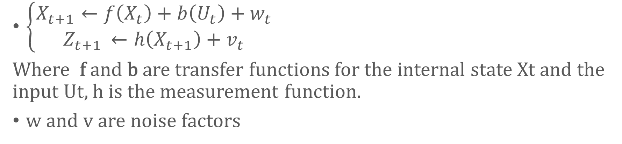
Introduction to Kalman Filter
$\left\{\begin{matrix}X_{t+1}←f\left(X_{t}\right)+b\left(U_{t}\right)+w_{t} \\ Z_{t+1 }←h\left(X_{t+1}\right)+v_{t}\end{matrix}\right.$
Where f and b are transfer functions for the internal state Xt and the input Ut, h is the measurement function.
w and v are noise factors
(Kalman, 1960)

Slide 4
Introduction to Kalman Filter (Cont’d)
Slide 4
Input and output are given, try to estimate the hidden state
Linear
Non-linear:
  Extended Kalman filter
  Unscented Kalman filter
IPTC-19207 • Deep Kalman Filter for Drilling Time Series • Y. Yu et al.

Slide 5
Drilling System Overview
Drilling Rig, Drilling Pipes, BHA, etc.
Earth Model
Driller:
Observables (Measurements)
Decision/Action (Control)

Slide 6


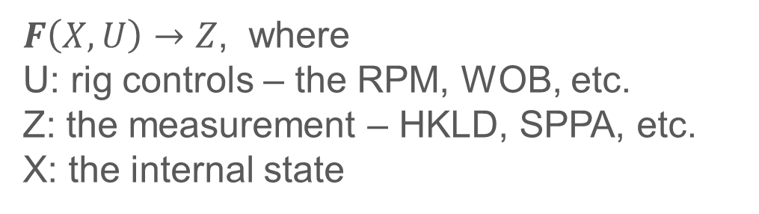
Rig Dynamics Representation Using Kalman Filter
$F\left(X, U\right)→Z$, where
U: rig controls – the RPM, WOB, etc.
Z: the measurement – HKLD, SPPA, etc.
X: the internal state
Control: U
Measurement: Z
Internal state: X
$\left\{\begin{matrix}X_{t+1}←f\left(X_{t}\right)+b\left(U_{t}\right)+w_{t} \\ Z_{t+1 }←h\left(X_{t+1}\right)+v_{t}\end{matrix}\right.$

Slide 7
Data-Driven Method
Slide 7
Solving the Kalman filter with Deep Neural Networks
  Not focus on the values of the hidden states
  The hidden states can be implicitly defined with neurons
  Goal is the predict the response/output from input
The big question: Can the neural network capture the complex physics of a drilling rig?
IPTC-19207 • Deep Kalman Filter for Drilling Time Series • Y. Yu et al.

Slide 8
Graphic Representation of Kalman Filter Equations
Slide 8
$$\left\{\begin{matrix}X_{t+1}←f\left(X_{t}\right)+b\left(U_{t}\right)+w_{t} \\ Z_{t+1 }←h\left(X_{t+1}\right)+v_{t}\end{matrix}\right.$$
R
b
Xt
h
Ut-1
+
Zt
Feature Extractor
CNN
Classification/Regression:
Fully Connected
f
Z⁻¹
Recurrent:
RNN, LSTM
IPTC-19207 • Deep Kalman Filter for Drilling Time Series • Y. Yu et al.

Slide 9
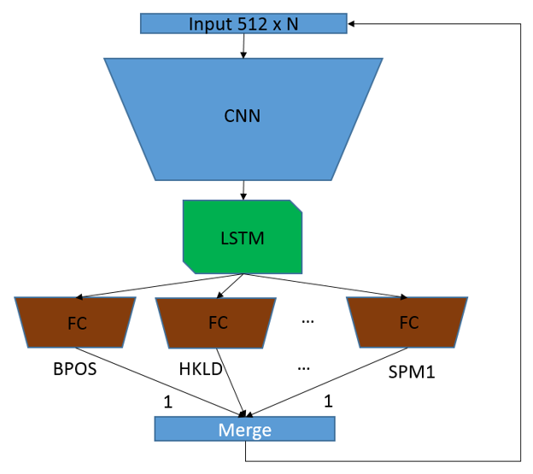
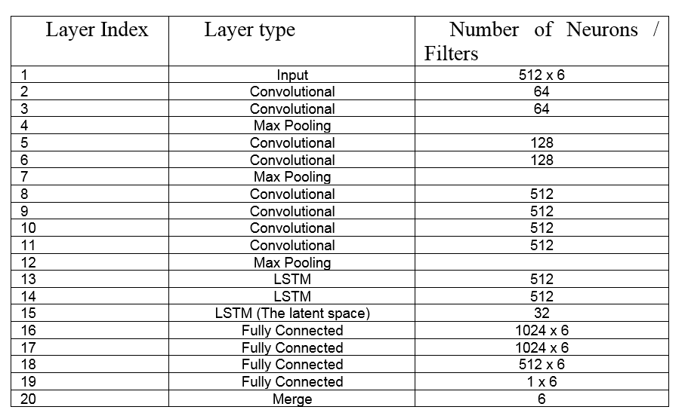
Architecture (for data generation)
Slide 9
$$\left\{\begin{aligned}X_{t+1}←F\left(X_{t}\right)+B\left(Z_{t−w:t}\right) \\ Z_{t+1 }←H(X_{t+1})\end{aligned}\right.$$
SPE-189591-MS
IPTC-19207 • Deep Kalman Filter for Drilling Time Series • Y. Yu et al.

Slide 10
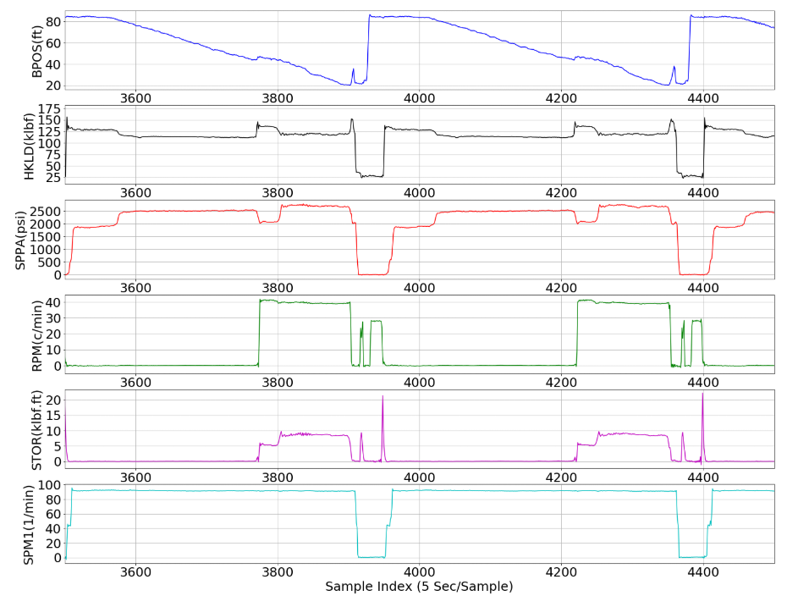
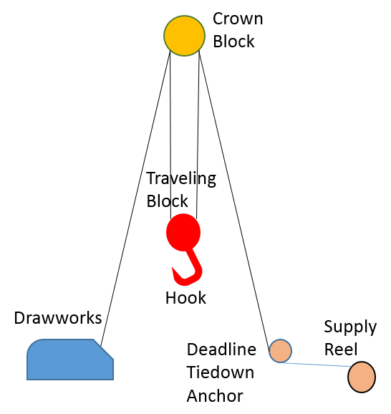
Application: Generating Drilling Time Series
A – the “noise”-like dynamics observed in HKLD and STOR,
B – the spikes in HKLD, STOR, and RPM, and
C – the subtle signal variation patterns in all the channels.
SPE-189591-MS

Slide 11
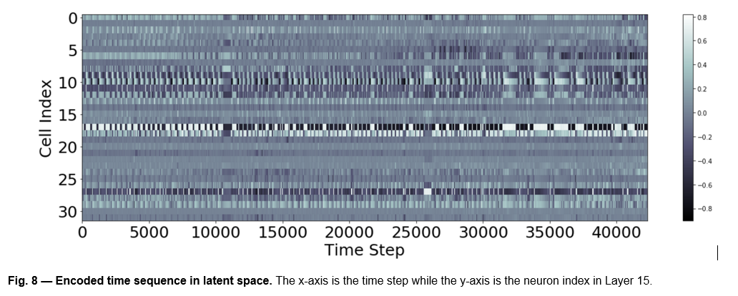
The Hidden Space
Slide 11
$$\left\{\begin{aligned}X_{t+1}←F\left(X_{t}\right)+B\left(Z_{t−w:t}\right) \\ Z_{t+1 }←H(X_{t+1})\end{aligned}\right.$$
SPE-189591-MS

Slide 12
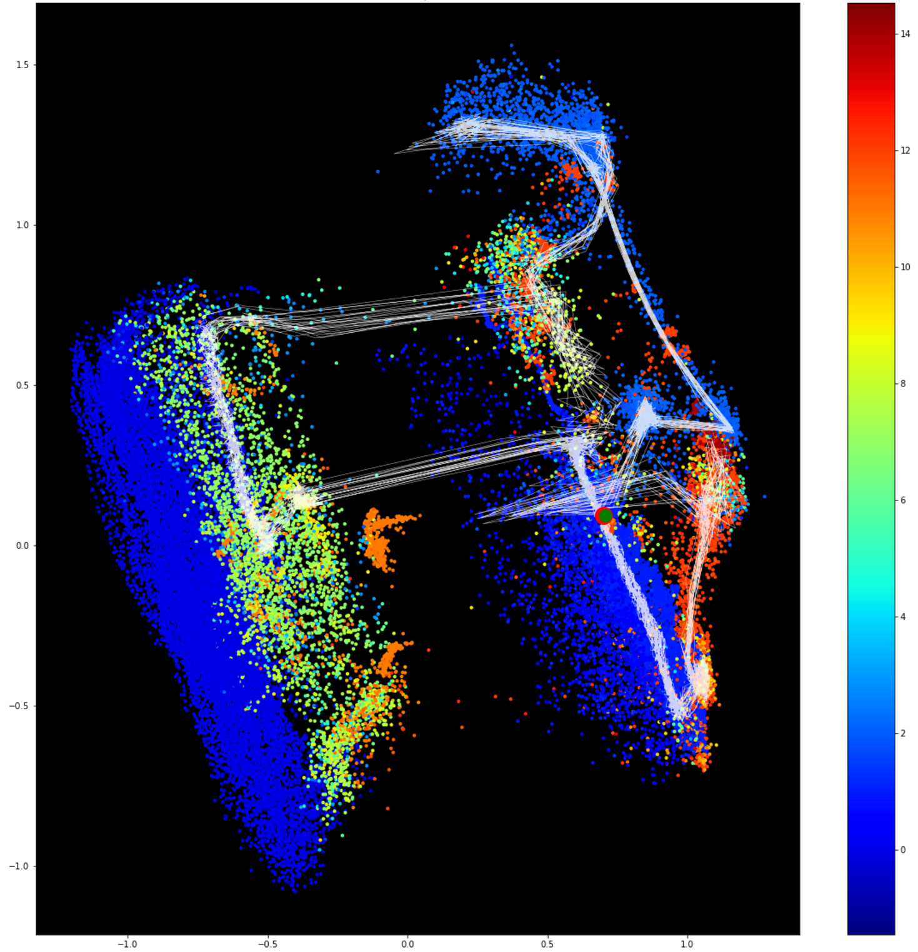
Slide 12
$$\left\{\begin{aligned}X_{t+1}←F\left(X_{t}\right)+B\left(Z_{t−w:t}\right) \\ Z_{t+1 }←H(X_{t+1})\end{aligned}\right.$$
SPE-189591-MS

Slide 13
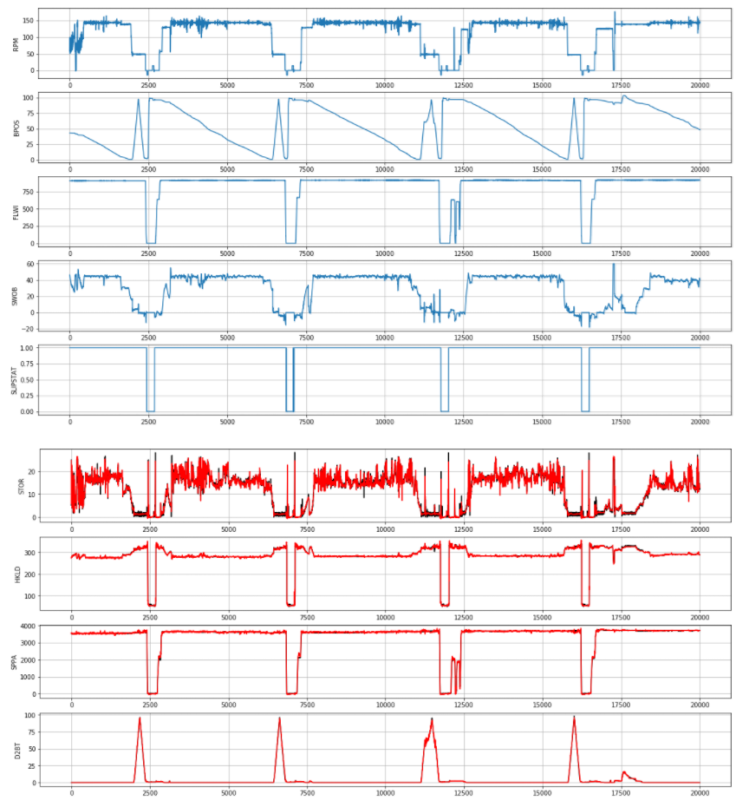
DKF (Regression Task): Control-Response Mode
Slide 13
Network Architecture for Single Sample Prediction
$$\left\{\begin{matrix}X_{t}←F\left(X_{t−1}\right)+B\left(U_{t−w:t}\right) \\ Z_{t }←H\left(X_{t}\right)\end{matrix}\right.$$
IPTC-19207 • Deep Kalman Filter for Drilling Time Series • Y. Yu et al.

Slide 14
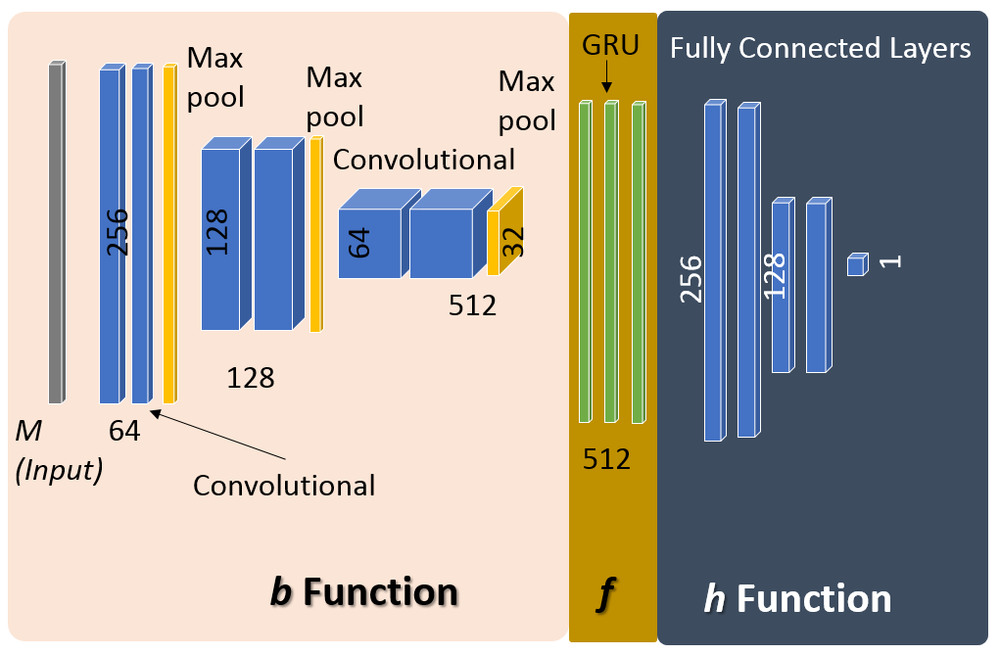
Deep Kalman Filter (DKF) as a Classifier
IPTC-19207 • Deep Kalman Filter for Drilling Time Series • Y. Yu et al.

Slide 15
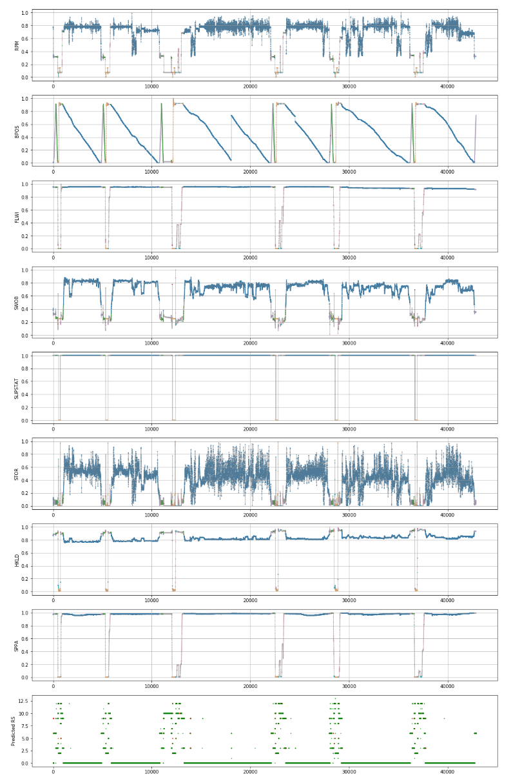
Slide 15
EXPERIMENT: PREDICTING RIG STATE
Input: 256 x 8
Output: 256 x 14 channels
Index | State
0 | Rotary Drilling
1 | Slide Drilling
2 | In Slips
3 | Reaming
4 | Tripping in, Pumping
5 | Tripping in, Rotating
6 | Tripping In
7 | Back Reaming
8 | Tripping out, Pumping
9 | Tripping out, Rotating
10 | Tripping Out
11 | Rotating & Pumping
12 | Pumping
13 | Rotating
14 | Stationary
15 | Unknown
Accuracy 97.5%
Training on 80% (158K samples)
Testing on 20% (42K samples)
IPTC-19207 • Deep Kalman Filter for Drilling Time Series • Y. Yu et al.

Slide 16
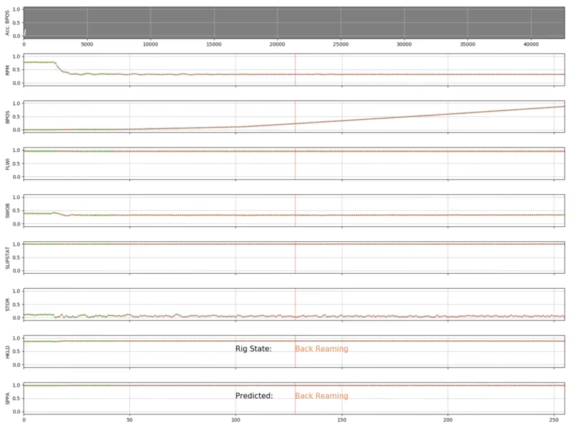
Rig State Prediction
Slide 16
IPTC-19207 • Deep Kalman Filter for Drilling Time Series • Y. Yu et al.

Slide 17
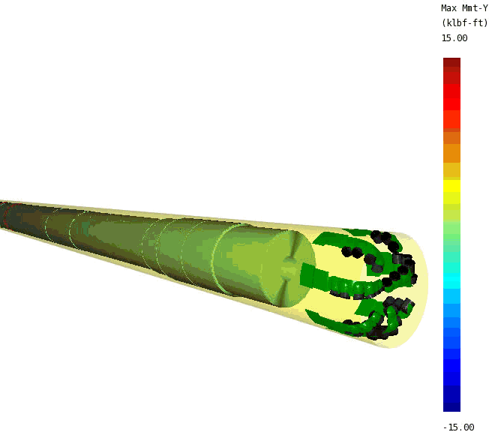
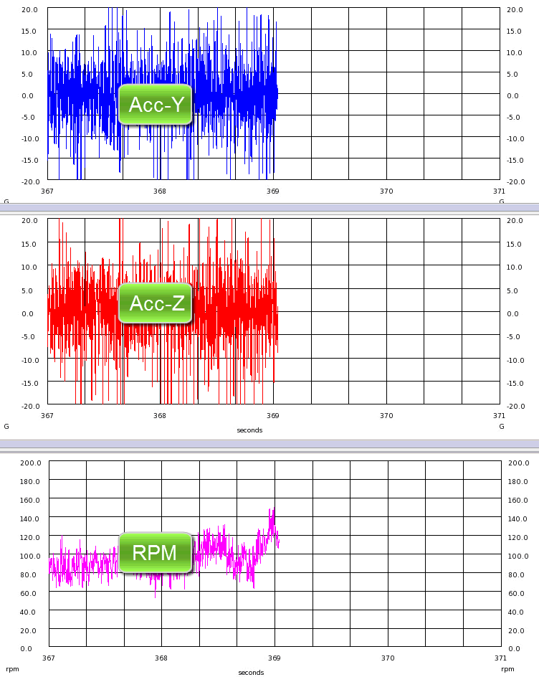
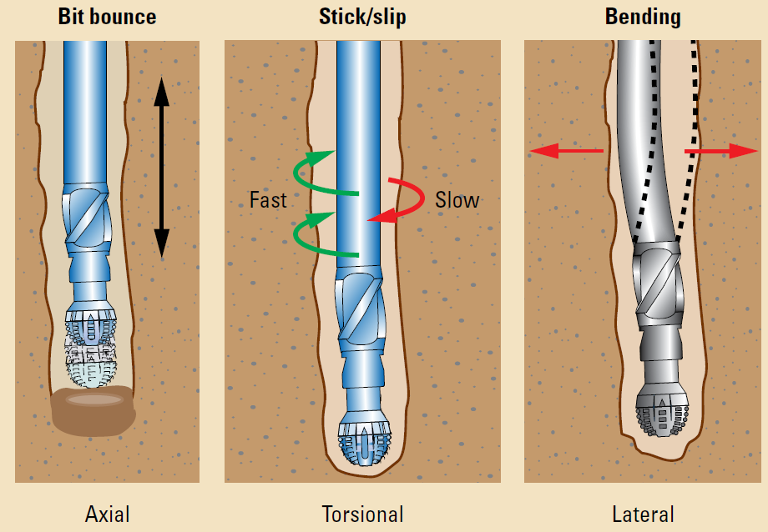
DKF for Unsupervised Learning: Drilling Dynamic Pattern Analysis
SPE-195919

Slide 18
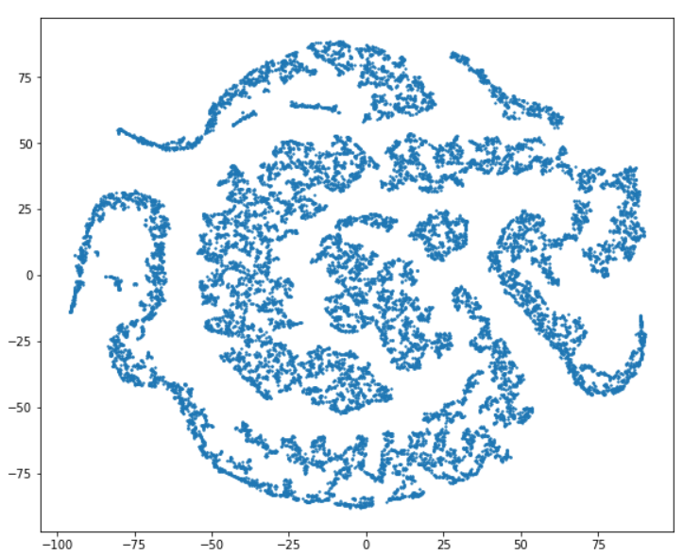
Extract Features
Input: w x n channel
Convolutional
Layers
Fully Connected
Features are encoded in this Latent-space with 8 neurons
FC
FC
…
FC
Note:
w: window size (128)
Acc_Y
Acc_Z
…
RPM
Regression Output: The (w+1)th sample
SPE-195919

Slide 19
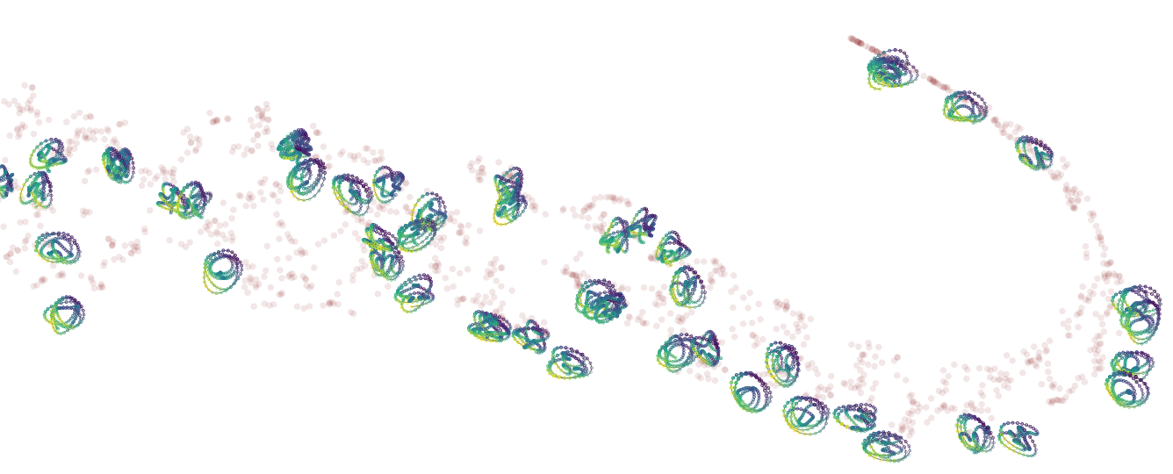
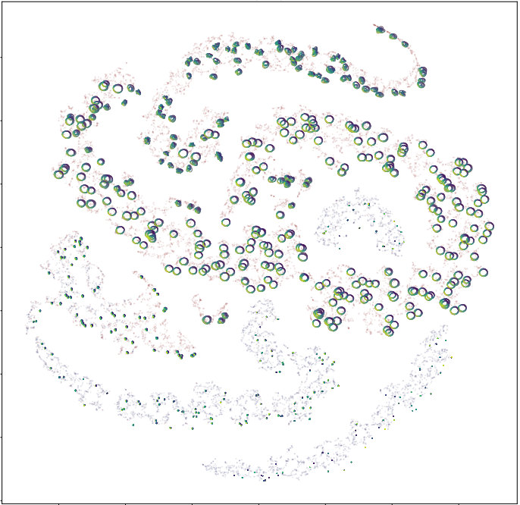
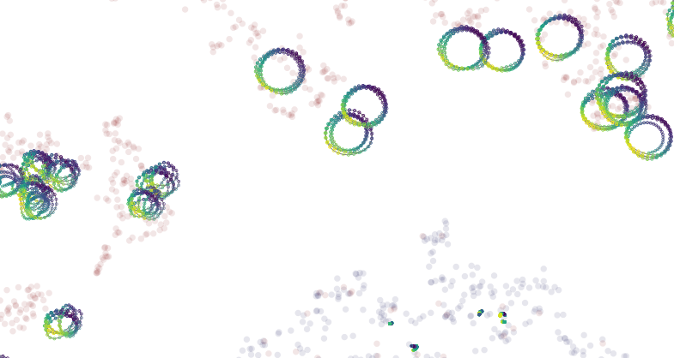
Feature Clustering (T-SNE)
SPE-195919

Slide 20
Summary
Slide 20
Deep Kalman Filter, an DNN implementation of Kalman Filter
Complex spatio-temporal patterns that models the nontrivial physical rules and properties
A general framework for time series analysis
Applications
  Data generation
  Regression: Control-response
  Classification
  Unsupervised Learning

Slide 21
Reference
Kalman, R. E., 1960. "A New Approach to Linear Filtering and Prediction Problems". Journal of Basic Engineering. 82: 35. doi:10.1115/1.3662552.
Yu, Y., Chambon, S., Liu, Q. and Belaskie, J., 2018. Recorded Well Data Enriches the Testing of Automation Systems by Using a Deep Neural Network Approach, Presented at the SPE IADC Drilling Conference and Exhibition, March 2018, Fort Worth, Texas, USA. 6-8 March.
Yu. Y., Liu, Q., Chambon, S., and Hamzah, M., Using Deep Kalman Filter to Predict Drilling Time Series, International Petroleum Technology Conference, March, 2019. Beijing, China
Chen. W., Yu Y, Shen Y., Zhang Z., and Vesselinov, V., Automatic Drilling Dynamic Interpretation using Deep Learning, SPE Annual Technical Conference and Exhibition, Sept 2019, Canada
C Jeong, Y Yu, D Mansour, V Vesselinov, and R Meehan, A Physics Model Embedded Hybrid Deep Neural Network for Drillstring Washout Detection. the SPE IADC Drilling Conference and Exhibition, March 2020, Galveston, TX, USA.

Slide 22
Slide 4
Acknowledgements
The authors would like to thank Schlumberger for the support and the permission of publication.

